Slide 1
Shell Bootcamp 2024 3 Reflections for Week #3
Achal Shankar Gupta
Date : 13-Sep-2024

Slide 2

About Me
“I am not afraid of storms for I am learning how to sail my ship.”

Slide 3

My learnings from this week!

Slide 4
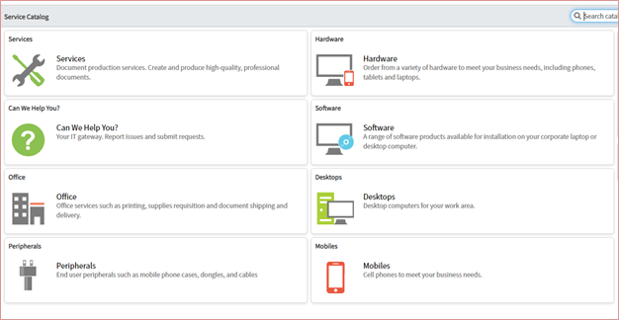
Learning 1 | My takeaways
Learned about ITIL, its objectives, components, and framework. Additionally, explored ServiceNow, understanding its features, applications, and processes for managing incidents, problems, changes, and service requests.
ITIL and ServiceNow improves efficiency, accountability, and service quality through clear processes for handling incidents, problems, and service requests.
In the energy sector, ITIL frameworks and tools like ServiceNow can be used to ensure smooth operation of IT services, manage incidents efficiently, and minimize downtime, helping Shell maintain critical infrastructure and meet service level agreements.

Slide 5

Learning 2 | My takeaways
I learned about AWS and its core services like EC2, S3, EBS, and VPC. I gained practical experience by creating two EC2 instances (one with a public IP and one without), connecting to them using SSH, and linking both S3 buckets and EBS storage to the public instance.
Understanding AWS services and how to set up, configure, and connect instances and storage is essential for managing cloud-based infrastructure efficiently and securely.
AWS can be used to manage scalable cloud infrastructure, enabling Shell to run critical applications, store vast amounts of data, and ensure secure access to resources.

Slide 6
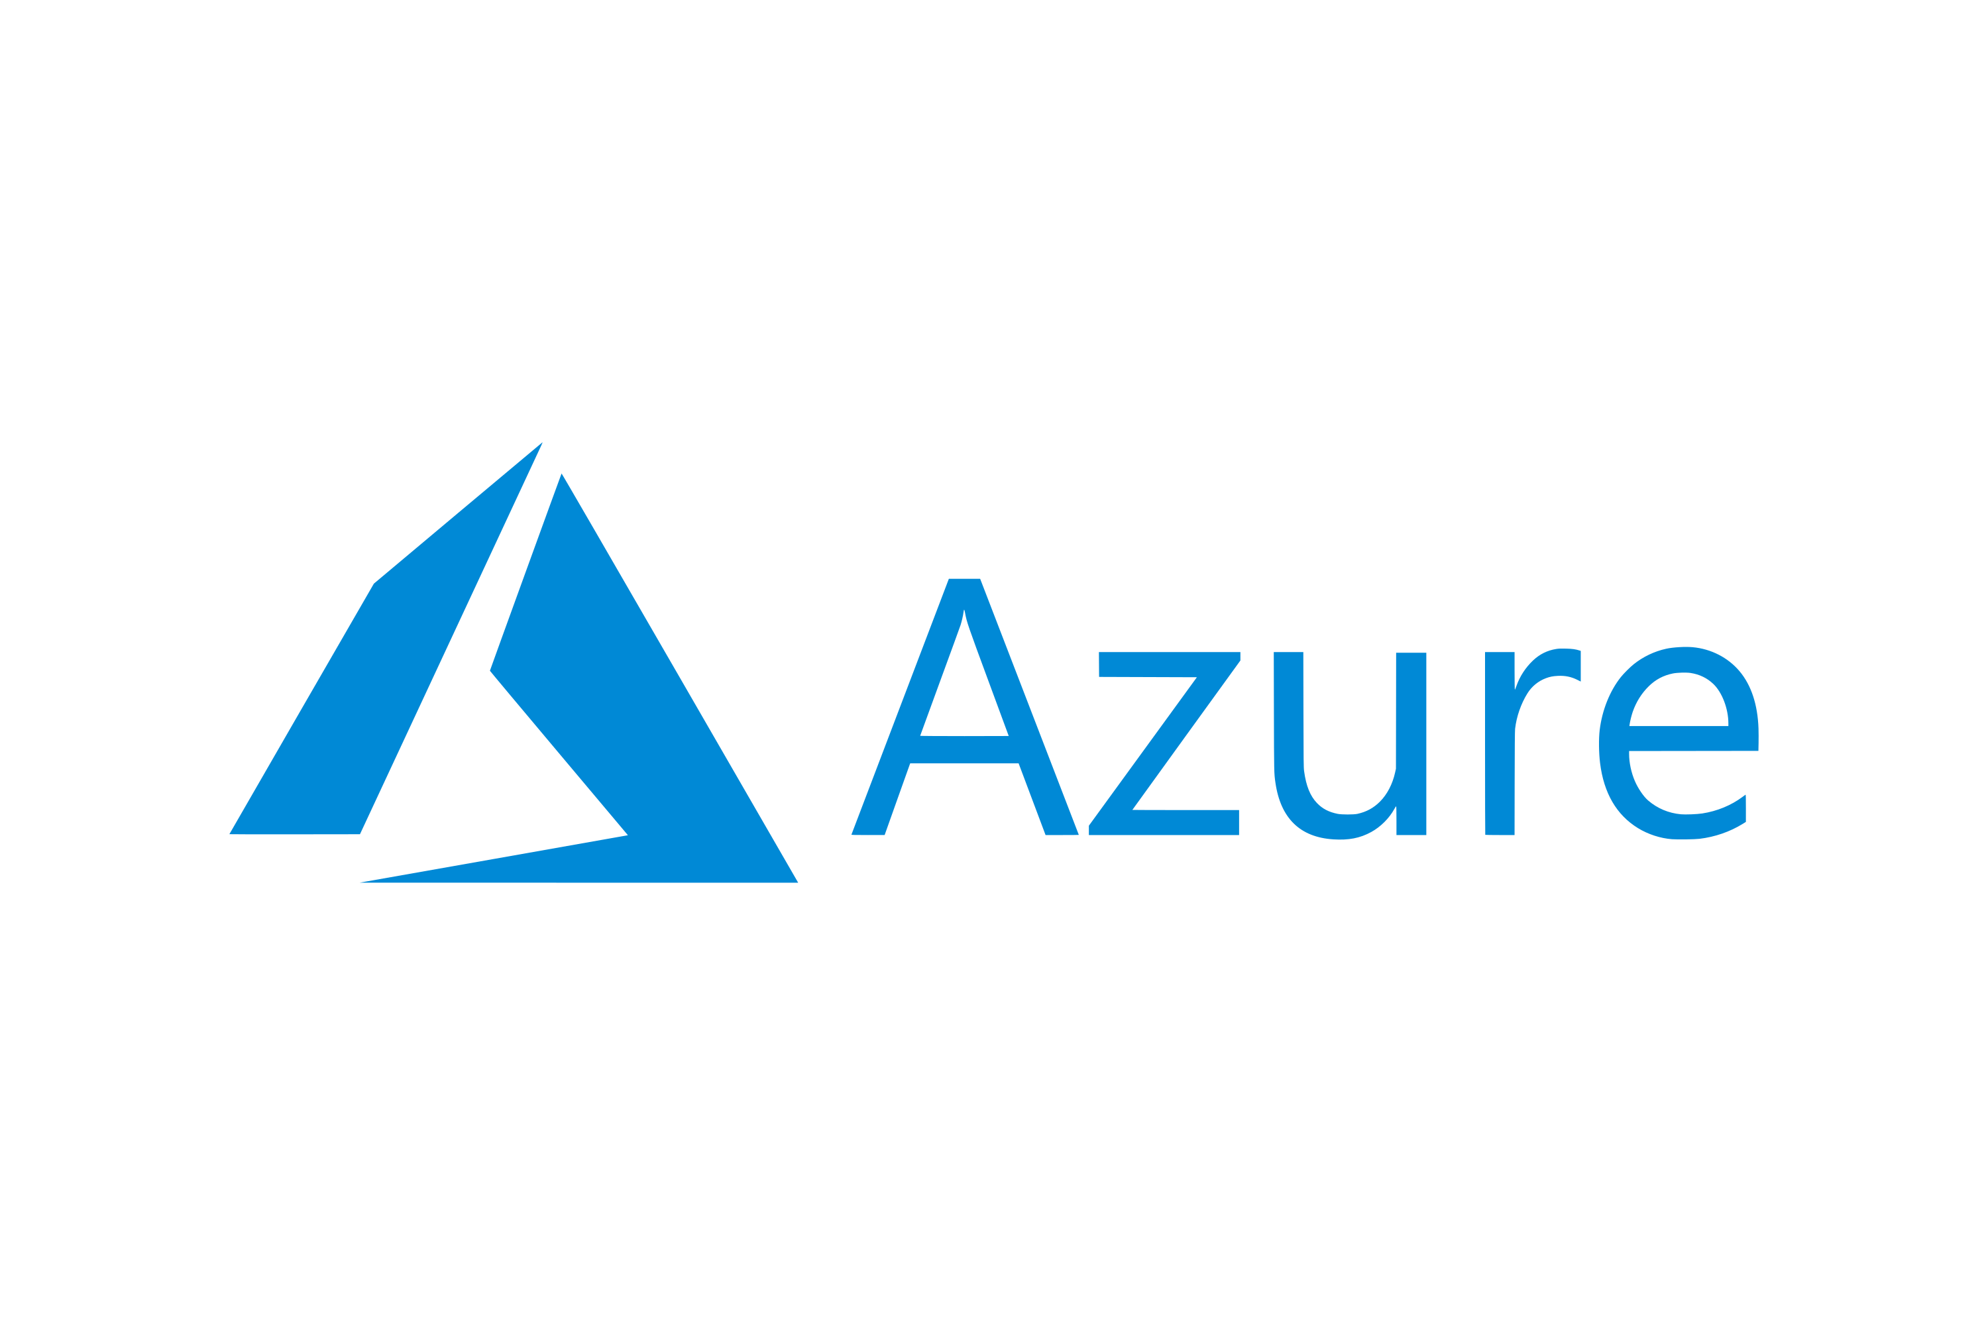
Learning 3 | My takeaways
I learned about Azure's core services, such as Virtual Machines (VM), File Storage, and Blob Storage. During the hands-on session, I created two VMs (one with a public IP and one without) and connected to the public VM via SSH, then accessed the private VM through the public one.
Understanding Azure’s infrastructure and how to manage VMs, storage solutions, and secure connections is essential for effectively deploying and managing cloud-based services.
Azure’s services can help Shell optimize cloud infrastructure for scalable storage, secure data management, and seamless communication between virtual networks.

Slide 7

Relevance of learnings for my organization

Slide 8

Learning 1 | Relevance for Shell
By using ITIL and ServiceNow, Shell benefits from improved service management, quicker incident resolution, and better adherence to service level agreements. This reduces downtime, ensures reliability, and enhances overall IT service quality, supporting Shell’s critical energy operations.

Slide 9

Learning 2 | Relevance for Shell
Shell likely uses AWS services such as EC2, S3, and EBS to manage cloud infrastructure for scalable data storage and computing. By leveraging these services, Shell can efficiently deploy and manage applications while ensuring secure access to its resources across global operations.

Slide 10

Learning 3 | Relevance for Shell
Shell likely implements Azure's core services, such as Virtual Machines, Blob Storage, and secure networking, to manage cloud-based infrastructure. By utilizing these services, Shell can efficiently run applications, store vast amounts of data, and securely connect its global operations.

Slide 11

Challenges in implementing learning

Slide 12
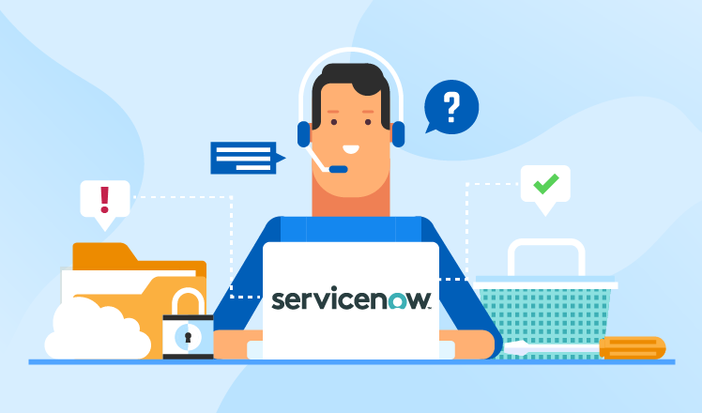
Challenge faced while implementing Learning 1
When creating and resolving service and incident request tickets in ServiceNow, I initially found it difficult to manage multiple users and navigate the different processes. It took me a while to get comfortable with the interface and streamline the workflow.

Slide 13
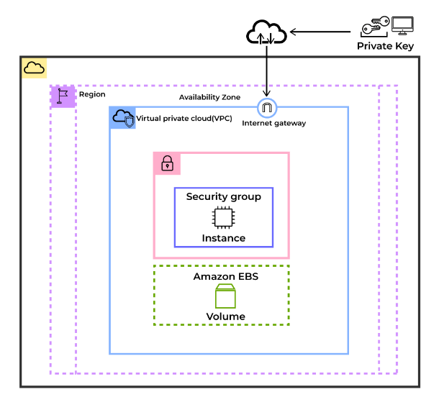
Challenge faced while implementing Learning 2
During the AWS hands-on session, I struggled to correctly configure SSH access to the private EC2 instance via the public one. I realized I need to deepen my understanding of network configurations and security group settings.

Slide 14

Challenge faced while implementing Learning 3
While working with Azure, I found it challenging to connect to the private VM through the public one. It took me some time to understand how to set up secure networking between the two VMs, highlighting the need to improve my skills in managing Azure's virtual network configurations.

Slide 15

Action Plan

Slide 16
My Action Plan for this Week
Actions
Timeline
Status
Revisit ServiceNow tutorials, review AWS documentation on SSH access and network configurations, and explore Azure’s virtual network settings.
Start immediately and aim to get hands on with ServiceNow, AWS and Azure.
Comfortable navigating ServiceNow and managing tickets efficiently, improved understanding of AWS network configurations, and confident in setting up secure connections between Azure VMs.

Slide 17

Learning is also Fun!

Slide 18
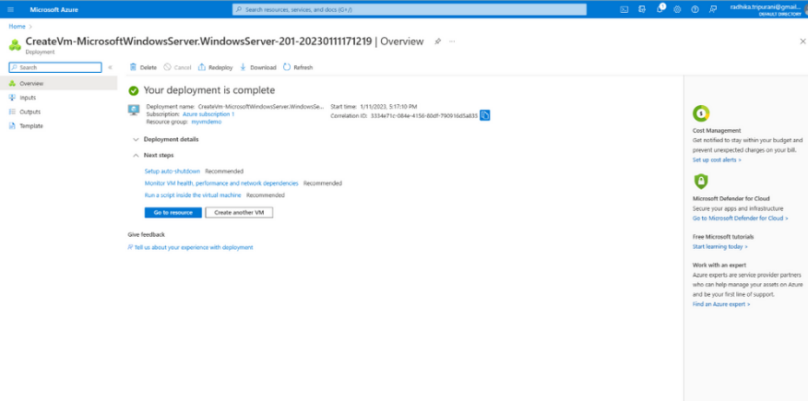
Learning is also Fun!
On the last day, we created two VMs on Azure—one private and one public. Our task was to connect to the private VM using the public one. This hands-on exercise was incredibly fun and engaging, making it a truly interesting experience.

Slide 19

Summary
This week focused on getting hands-on IDSO specific technical tools such as ServiceNow, AWS and Azure.
The upcoming week will dive into the remaining tools such as Docker, Kubernetes and Terraform.
The cloud technologies and ServiceNow are commonly used tools in my department and will surely help me in my work.

Slide 20
Thank You

